Slide 1
Chapter Four
Switches
By Cheru H.

Slide 2
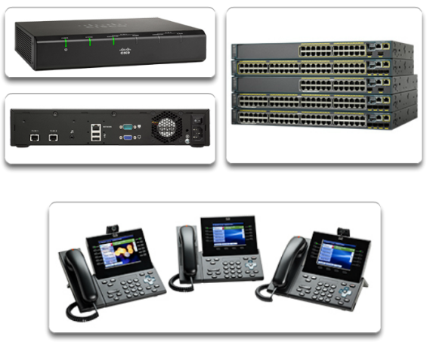
Growing Complexity of Networks
Our digital world is changing.
Information must be accessed from anywhere in the world.

Slide 3
Elements of a Converged Network
To support collaboration, networks employ converged solutions.
Data services include voice systems, IP phones, voice gateways, video support, and video conferencing.
Call control, voice messaging, mobility, and automated attendant are also common features.
Multiple types of traffic; only one network to manage.
Substantial savings over installation and management of separate voice, video, and data networks.
Integrates IT management.

Slide 4
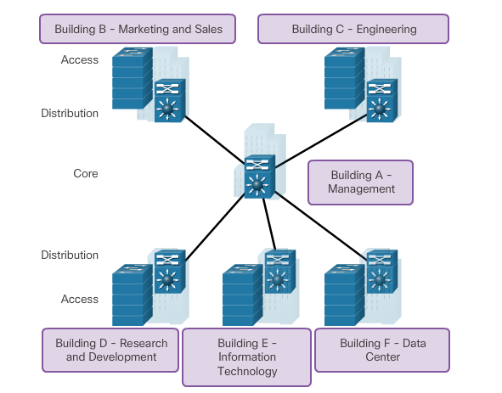
Network design

Slide 5
Role of Switched Networks
Switching technologies are crucial to network design.
Switching allows traffic to be sent only where it is needed in most cases, using fast methods.
A switched LAN:
Allows more flexibility
Allows more traffic management
Supports quality of service, additional security, wireless, IP telephony, and mobility services

Slide 6
Switched Network
A switch makes a decision based on ingress and a destination port.
A LAN switch keeps a table that it uses to determine how to forward traffic through the switch.
Cisco LAN switches forward Ethernet frames based on the destination MAC address of the frames.

Slide 7
CAM
A switch must first learn which devices exist on each port before it can transmit a frame.
As a switch learns the relationship of ports to devices, it builds a table called a MAC address or content addressable memory (CAM) table.
CAM is a special type of memory used in high-speed searching applications.
The information in the MAC address table is used to send frames.
When a switch receives an incoming frame with a MAC address that is not found in the CAM table, it floods it to all ports, except the one that received the frame.

Slide 8
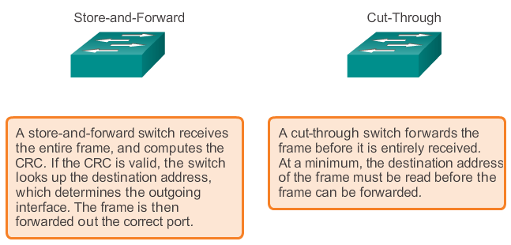
Switch Forwarding Methods

Slide 9
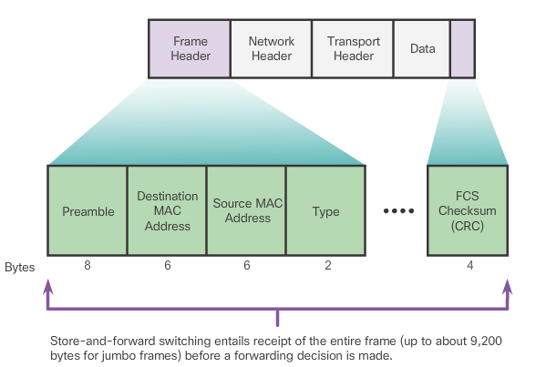
Store-and-Forward Switching
Allows the switch to:
Check for errors (via FCS check)
Perform automatic buffering
Slower forwarding process

Slide 10
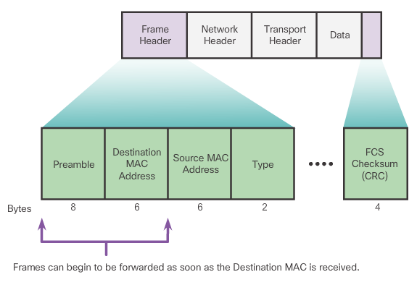
Cut-Through Switching
Allows the switch to start forwarding in about 10 microseconds
No FCS check
No automatic buffering

Slide 11
Collision Domains
Collision domain - Segment where devices compete to communicate.
Ethernet switch port:
Operating in half duplex, each segment is in its own collision domain.
Operating in full duplex eliminates collisions.
By default, will auto-negotiate full duplex when the adjacent device can also operate in full duplex.

Slide 12
Broadcast Domains
A broadcast domain is the extent of the network where a broadcast frame can be heard.
Switches forward broadcast frames to all ports; therefore, switches do not break broadcast domains.
All ports of a switch, with its default configuration, belong to the same broadcast domain.
If two or more switches are connected, broadcasts are forwarded to all ports of all switches, except for the port that originally received the broadcast.

Slide 13
Switch Boot Sequence
Power-on self test (POST).
Run boot loader software.
Boot loader performs low-level CPU initialization.
Boot loader initializes the flash file system.
Boot loader locates and loads a default IOS operating system software image into memory and passes control of the switch over to the IOS.

Slide 14
Switch Boot Sequence (cont.)
To find a suitable Cisco IOS image, the switch goes through the following steps:
Step 1. It attempts to automatically boot by using information in the BOOT environment variable.
Step 2. If this variable is not set, the switch performs a top-to-bottom search through the flash file system. It loads and executes the first executable file, if it can.
Step 3. The IOS software then initializes the interfaces using the Cisco IOS commands found in the configuration file and startup configuration, which is stored in NVRAM.
Note: The boot system command can be used to set the BOOT environment variable. Use the show boot command to see to what the current IOS boot file is set.

Slide 15
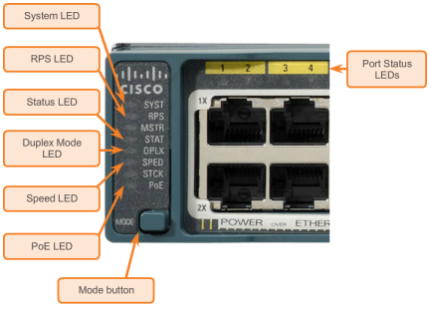
Switch LED Indicators
Each port on Cisco Catalyst switches have status LED indicator lights.
By default, these LED lights reflect port activity, but they can also provide other information about the switch through the Mode button.
The following modes are available on Cisco Catalyst 2960 switches:
System LED
Redundant Power System (RPS) LED
Port Status LED
Port Duplex LED
Port Speed LED
Power over Ethernet (PoE) Mode LED

Slide 16
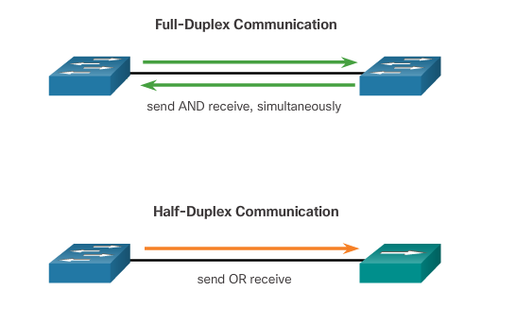
Duplex Communication

Slide 17
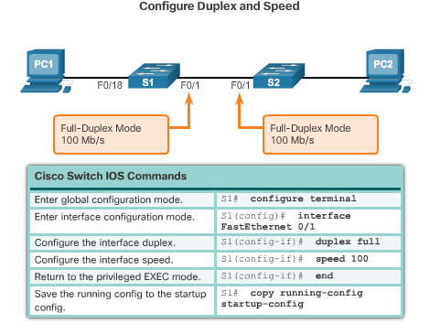
Configure Switch Ports at the Physical Layer

Slide 18
Auto-MDIX
Certain cable types (straight-through or crossover) were historically required when connecting devices.
The automatic medium-dependent interface crossover (auto-MDIX) feature eliminates this problem.
When auto-MDIX is enabled, the interface automatically detects and appropriately configures the connection.
When using auto-MDIX on an interface, the interface speed and duplex must be set to auto.

Slide 19
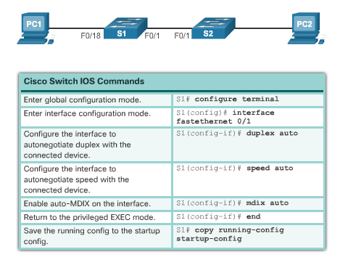
Cont’d…

Slide 20
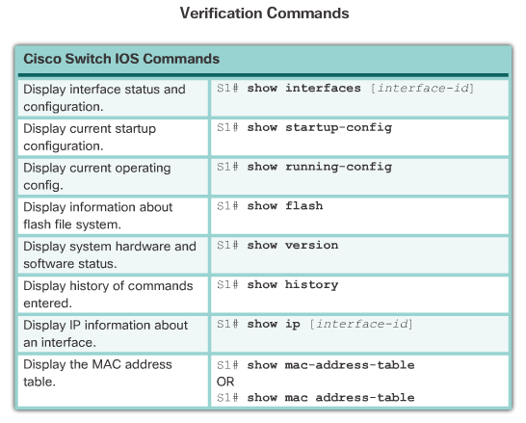
Verifying Switch Port Configuration

Slide 21
Port Security: Operation
The MAC addresses of legitimate devices are allowed access, while other MAC addresses are denied.
Any additional attempts to connect by unknown MAC addresses generate a security violation.
Secure MAC addresses can be configured in a number of ways:
Static secure MAC addresses – manually configured and added to running configuration - switchport port-security mac-address mac-address
Dynamic secure MAC addresses – removed when switch restarts
Sticky secure MAC addresses – added to running configuration and learned dynamically - switchport port-security mac-address sticky interface configuration mode command

Slide 22
Port Security: Violation Modes
IOS considers a security violation when:
The maximum number of secure MAC addresses for that interface have been added to the CAM, and a station whose MAC address is not in the address table attempts to access the interface.
There are three possible actions to take when a violation is detected:
Protect – no notification received
Restrict – notification received of security violation
Shutdown
switchport port-security violation {protect | restrict |shutdown} interface configuration mode command

Slide 23
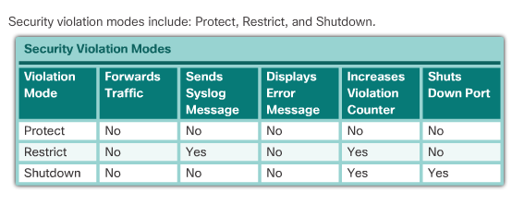
Cont’d…

Slide 24
VLAN
Read the vlan

Slide 25
Redundancy at OSI Layers 1 and 2
Switched networks commonly have redundant paths and even redundant links between the same two devices.
Redundant paths eliminate a single point of failure in order to improve reliability and availability.
Redundant paths can cause physical and logical Layer 2 loops.
Spanning Tree Protocol (STP) is a Layer 2 protocol that helps especially when there are redundant links.
Layer 2 loop issues
Mac database instability – copies of the same frame being received on different ports.
Broadcast storms – broadcasts are flooded endlessly causing network disruption.
Multiple frame transmission – multiple copies of unicast frames delivered to the same destination.

Slide 26
Issues with Layer 1 Redundancy: MAC Database Instability
Ethernet frames do not have a time to live (TTL) field like the Layer 3 IP header has. This means that Ethernet has no mechanism to drop frames that propagate endlessly. This can
result in MAC database instability.
PC1 sends a broadcast frame to S2.
S2 updates the MAC address table for PC1’s MAC address on port 11.
S2 forwards the frame out all ports except the port the frame came in on. S1 and S3 receive the frame on a trunk and update their own MAC address tables that PC1 is reachable through the trunk port.
S1 and S3 send the frame out all ports except the port it came in on.
When S1 sends the frame out port 2 (Trunk 3), S3 updates the MAC address table to reflect that PC1 is now reachable through port 1.
A host caught in a network loop is not accessible to other hosts.
Due to constant changes in the MAC address table, Switches S3 and S1 do not know which port to forward frames.

Slide 27
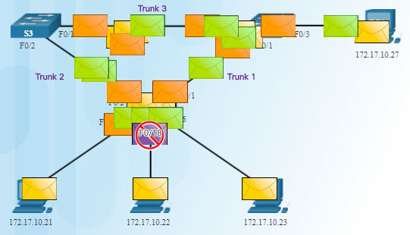
Issues with Layer 1 Redundancy: Broadcast Storms
Broadcast storm – so many broadcast frames in a Layer 2 loop that use all available bandwidth and make the network unreachable for legitimate network traffic.
Causes a denial of service (DoS)
Can develop in seconds and bring the network down

Slide 28
Issues with Layer 1 Redundancy: Duplicate Unicast Frames
An unknown unicast frame is when the switch does not have the destination MAC address in its MAC address table and has to broadcast the frame out all ports except the port the frame was received on (the ingress port).
Unknown unicast frames sent onto a looped network can result in duplicate frames arriving at the destination device.
PC1 sends a frame destined for PC4.
S2 does not have PC4’s MAC address in the MAC address table so it forwards the frame out all ports including the trunks that lead to S1 and S3. S1 sends the frame to PC4. S3 also sends a copy of the frame over to S1 which delivers the same frame again to PC4.

Slide 29
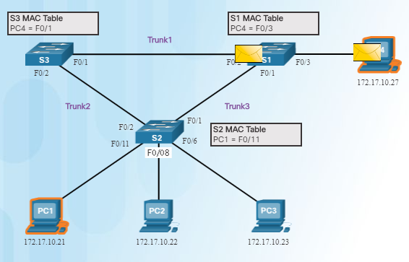
Cont’d…

Slide 30
Spanning Tree Algorithm: Introduction
The Spanning Tree Protocol (STP) creates one logical path through the switch network (all destinations on the network).
Blocks redundant paths that could cause a loop.
STP sends bridge protocol data units (BPDUs) between Layer 2 devices in order to create the one logical path.
A port on S2 is blocked so traffic can only flow one way between any two devices.
When Trunk1 fails, the blocked port on S2 is unblocked and traffic can flow between S2 and S3.

Slide 31
Spanning Tree Algorithm: Port Roles
Root bridge – one Layer 2 device in a switched network.
Root port – one port on a switch that has the lowest cost to reach the root bridge.
Designated port – selected on a per-segment (each link) basis, based on the cost to get back to root bridge for either side of the link.
Alternate port – (RSTP only) backup port for the designated port when the other side is not a root port.
Backup port – (RSTP only) backup port for the root port.

Slide 32
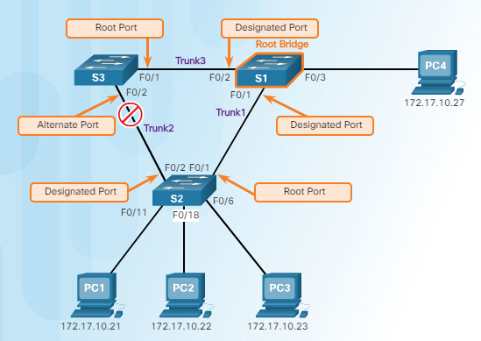
Cont’d…

Slide 33
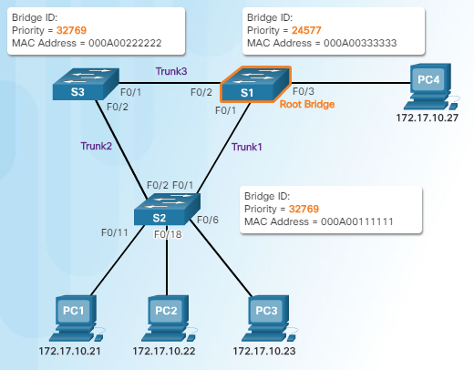
Spanning Tree Algorithm: Root Bridge
Lowest bridge ID (BID) becomes root bridge
Originally BID had two fields: bridge priority and MAC address
Bridge priority default is 32,768 (can change)
Lowest MAC address (if bridge priority is not changed) becomes determinant for root bridge.

Slide 34

Spanning Tree Algorithm: Root Path Cost
Root path cost is used to determine the role of the port and whether or not traffic is blocked.
Can be modified with the spanning-tree cost interface command.

Slide 35
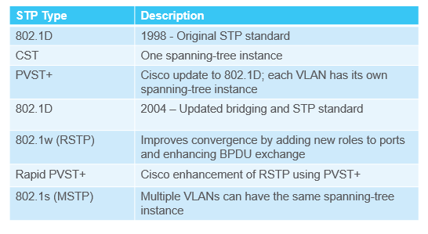
Types of Spanning Tree Protocols

Slide 36
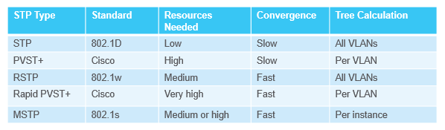
Characteristics of Spanning Tree Protocols

